Slide 1
Experience Prototyping
Session #02
Course : GAME6012/ User Experiences
Effective Period : September 2017

Slide 2
These slides have been adapted from:
Julie A. Kientz (2014). User Experience Design, University of Washington.
Acknowledgement

Slide 3
Learning Objectives

Slide 4
What is a prototype?

Slide 5
Sketches vs. Prototypes
Sketches are about exploring ideas
Prototypes are about testing ideas

Slide 6
Sketch vs. Prototype
Sketch | Prototype
Invite | Attend
Suggest | Describe
Explore | Refine
Question | Answer
Propose | Test
Provoke | Resolve
Tentative, non committal | Specific Depiction
The primary differences are in the intent

Slide 7
Prototypes vs. Mockups & Wireframes
Mock-ups and wireframes are static, representing a single state of the design
Prototypes are simulations/models of how the design is supposed to actual work

Slide 8
Prototype vs. System Development
In engineering, prototyping is system development: building the first example of a system by hand
In user interface design, the effort on the functionality of the system is minimized for the prototype
  Focus on the "visible" parts of the system
  Still a range, in terms of fidelity and level of activity, in relation to the final product

Slide 9
What does a prototype look like?
In designing interactive systems, it can be:
  a series of screen designs (e.g., from photoshop)
  a storyboard, i.e. a cartoon-like series of scenes
  a PowerPoint slide show or HTML pages
  a video simulating the use of a system
  a lump of wood (e.g. to represent a cell phone)
  a cardboard mock-up
  a piece of software with limited functionality written in the target language or in another language

Slide 10
Why should we prototype?
Evaluation and feedback are central to interaction design
Users can see, hold, interact with a prototype more easily than a document or a drawing
You can test out ideas for yourself
It encourages reflection: important aspect of design
Prototypes answer questions, and support designers in choosing between alternatives

Slide 11
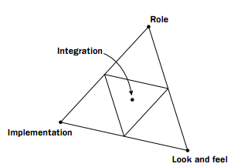
What do prototypes prototype?
(Houde & Hill)

Slide 12
What can prototypes tell us?
Interest: would people want this?
Use: does this solve a real problem?
Usability: is this easy, sensible, and effective?
Implementation: can this be done?

Slide 13
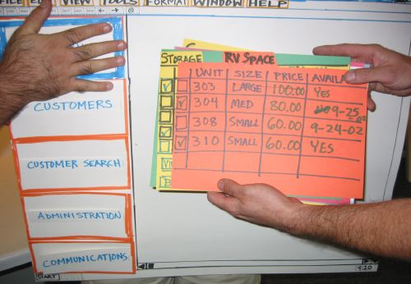
Low-Fidelity Prototyping (Lo-Fi)
Very far from the final product, e.g. paper, cardboard, abstract
Examples:
sketches of screens, task
sequences, etc.
‘Post-it’ notes
Storyboards
Scenarios

Slide 14
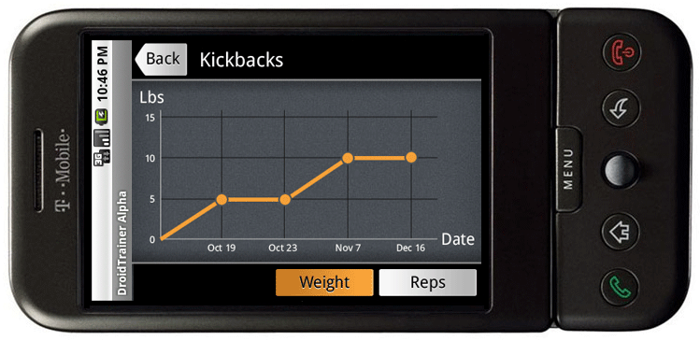
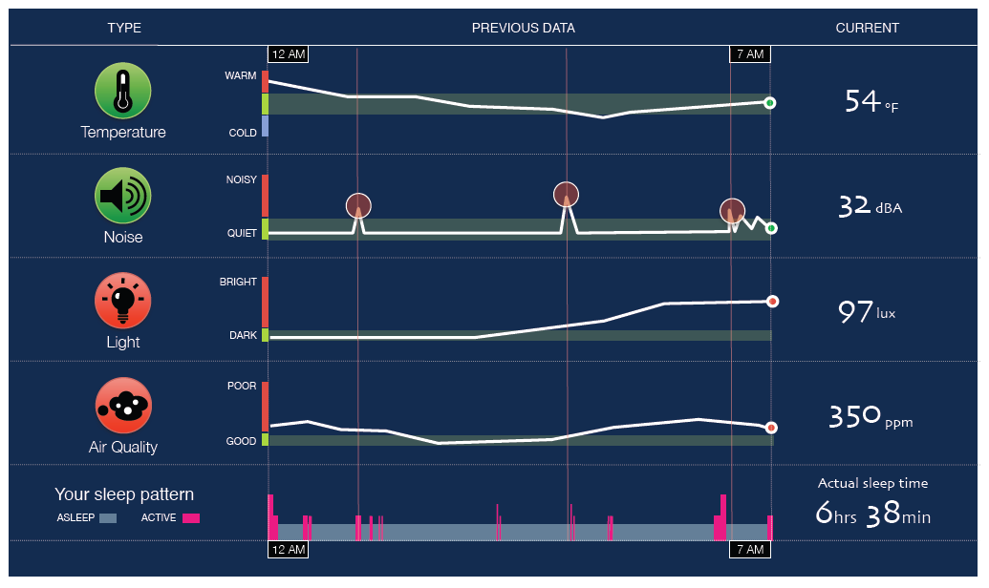
High-Fidelity Prototyping (Hi-Fi)
Prototype looks more like the final system than a low-fidelity version
Common hi-fi prototyping tools:
  Photoshop, Axure, Flash, PowerPoint

Slide 15
Hi-Fi vs. Lo-Fi – How'd we do?
 | Lo – Fi | Hi – Fi
Advantages | Fast Cheap Easy – kindergarten skills! Can simulate actual product | Better sense of finished product Can judge aesthetic appeal More realistic experience Can evaluate experience
Disadvantages | Slow response time Can’t get feedback about aesthetics User may question design quality | Users may focus on unnecessary details Takes a lot of time to make Users may lose track of big picture

Slide 16
Horizontal vs. Vertical
How much to represent?
  “Deep” or “vertical” prototyping
    provide a lot of detail for only a few functions
  “Broad” or “horizontal” prototyping
    provide a wide range of functions, but with little detail

Slide 17
Horizontal vs. Vertical
Horizontal prototype
(e.g., paper prototype)
Scenario
Full
interface
Vertical prototype
(e.g., photoshop
mock up)

Slide 18
Experience Prototyping
The key is making the interactions and experience as authentic to the real thing as possible
Typically a Hi-fidelity experience
Use Wizard-of-oz to save time and avoid complicated implementation

Slide 19
Running the Prototype
Practice with a friend first
Once you’re comfortable, recruit “users”
Two roles: facilitator and wizard
  Facilitator provides tasks (paper) and takes notes
  Wizard operates interface
    More authentic if hidden or remote
User feedback can be…
  Think aloud (speak freely as performing tasks)
  Retrospective (best when think aloud distracts)
Debrief users (reveal wizard if needed)
Klemmer HCI class

Slide 20
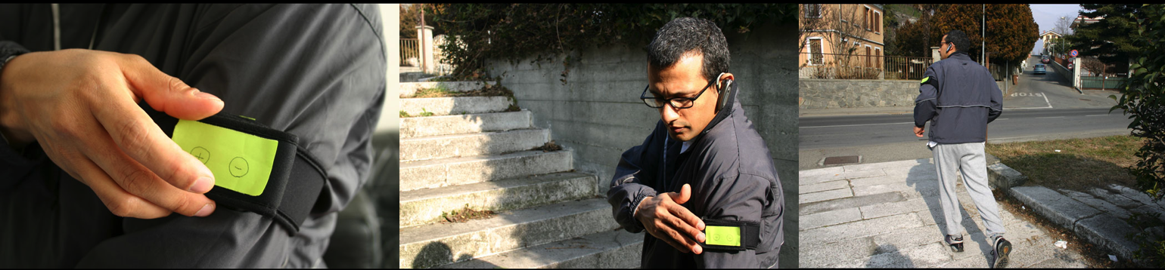
Experience Prototype Examples

Slide 21
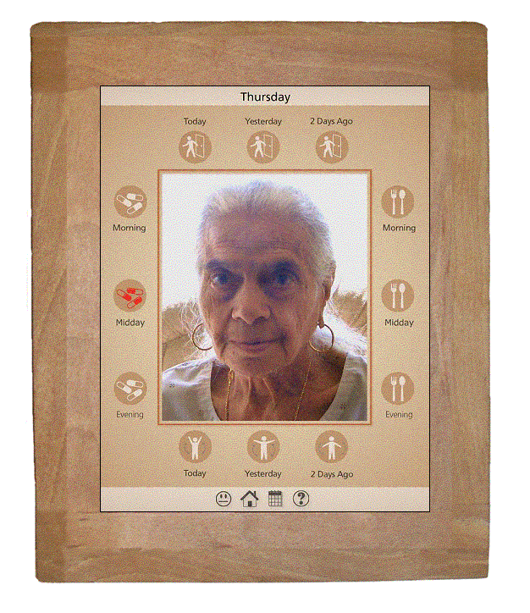
More Examples
CareNet Display (Consolvo et al., 2004)
  In-home display shows
  adult children how their
  aging parent is doing
  Design team called older
  person daily to collect
  information and updated
  display

Slide 22
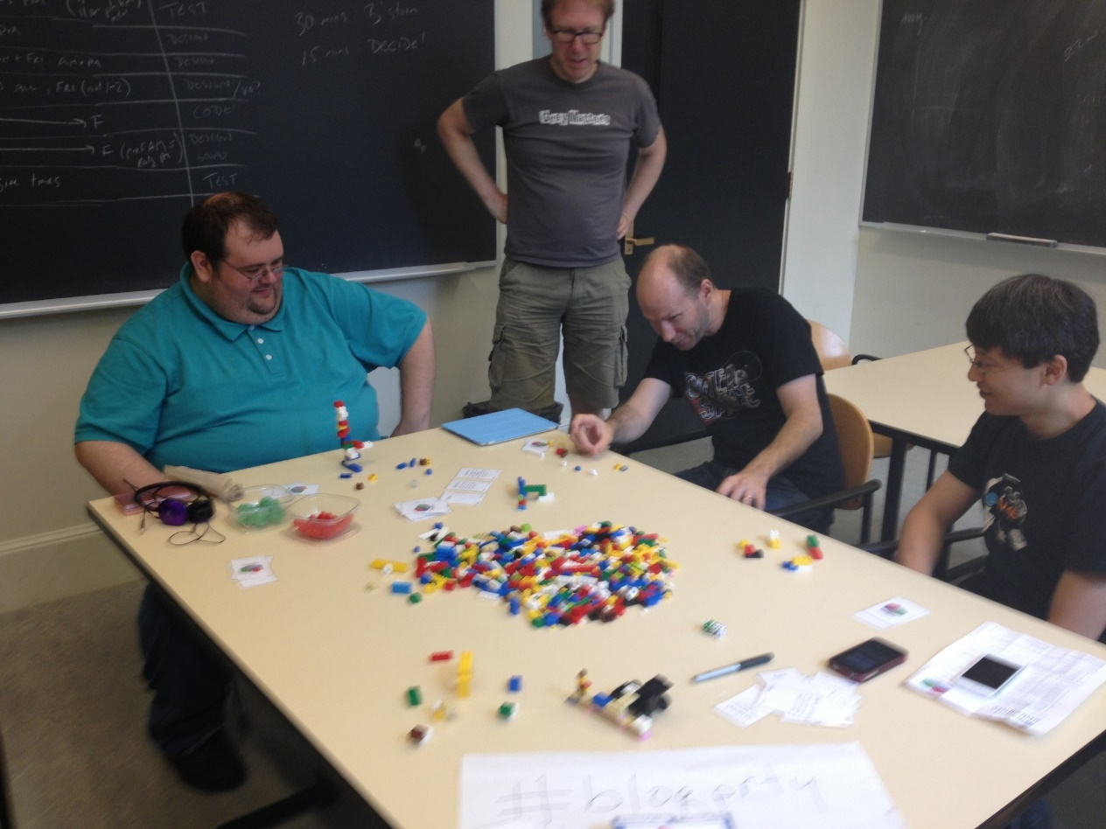
Game Prototyping

Slide 23
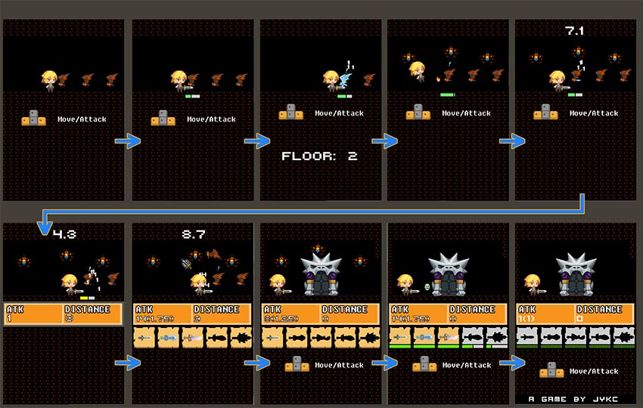
Game Design Prototyping

Slide 24
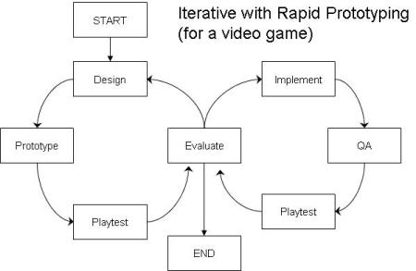
Game Prototyping

Slide 25
Assignment
Create a prototype from your sketch that you have developed from previous meeting

Slide 26
References
Buxton, William. 2007. Sketching user experience. Elsevier
Anderson, Stephen. 2011. Seductive Interaction Design. New Riders.
Faranello, Scott. 2016. Practical UX Design. Packt Publishing

